Slide 1
Data Science
What is Data Science?
Data science is the field of study that combines domain expertise, programming skills, and knowledge of mathematics and statistics to extract meaningful insights from data. Data science practitioners apply machine learning algorithms to numbers, text, images, video, audio, and more to produce artificial intelligence (AI) systems to perform tasks
that ordinarily require human intelligence.
In turn, these systems generate insights
which analysts and business users can
translate into tangible business value.

Slide 2
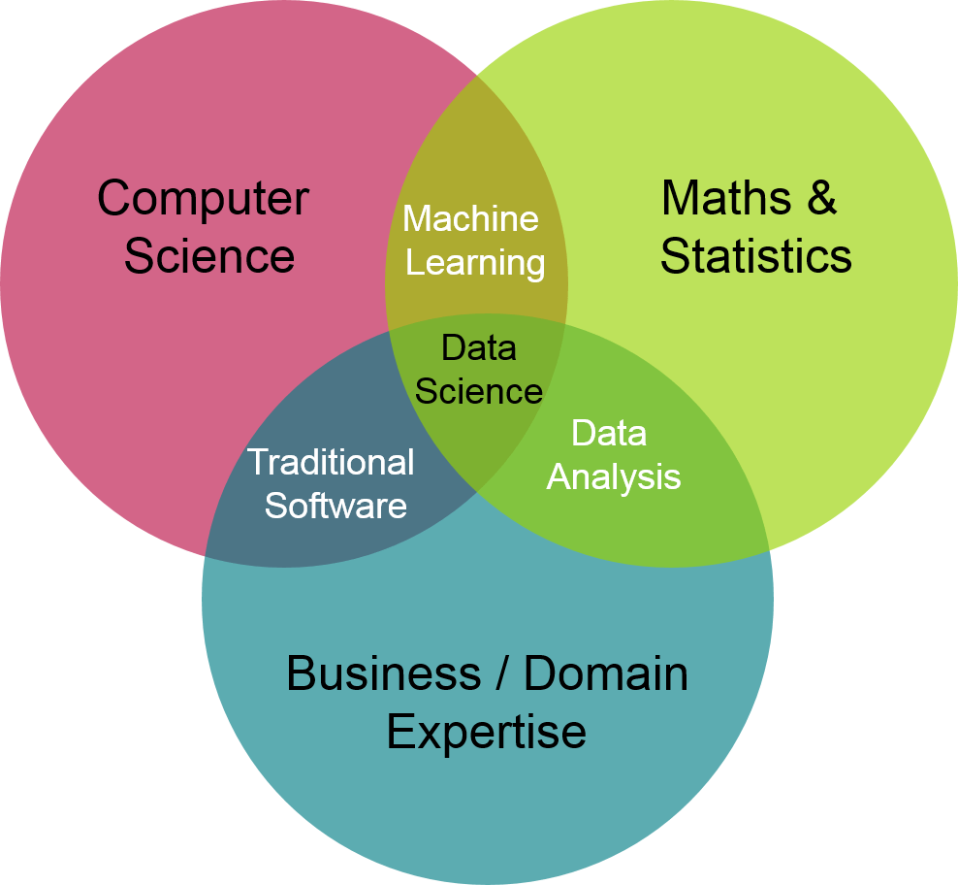

Slide 3
Why Data Science is Important?
More and more companies are coming to realize the importance of data science, AI, and machine learning.
Regardless of industry or size, organizations that wish to remain competitive in the age of big data need to efficiently
develop and implement data science capabilities or
risk being left behind.

Slide 4
Advantages of Data Science
High Demand:
Data science is in high demand in the current society. Almost every person is interested in this career data scientists are needed in the job market due to the large amounts on data being created every day it is predicted to create 11.5 million jobs by 2026. this makes data science a promising career in the future. With the high rate at which Data is generated a data scientist will be a very marketable person in the society, every company and cooperation will need one.

Slide 5
Improved healthcare:
In the healthcare sector, great improvements have taken place since the emergence of data science. With the advent of machine learning, it has been made easier to detect early-stage tumours. Also, many other health-care industries are using Data Science to help their clients. With the fight against diseases such as cancer, Data is an essential necessity that will help in the discovery of a cure with data science lives will change.
Customised user experience:
Data Science involves the use of machine learning which has enabled industries to create better products tailored specifically for customer experiences. For example, Recommendation Systems used by e-commerce websites provide personalized insights to users based on their historical purchases.

Slide 6
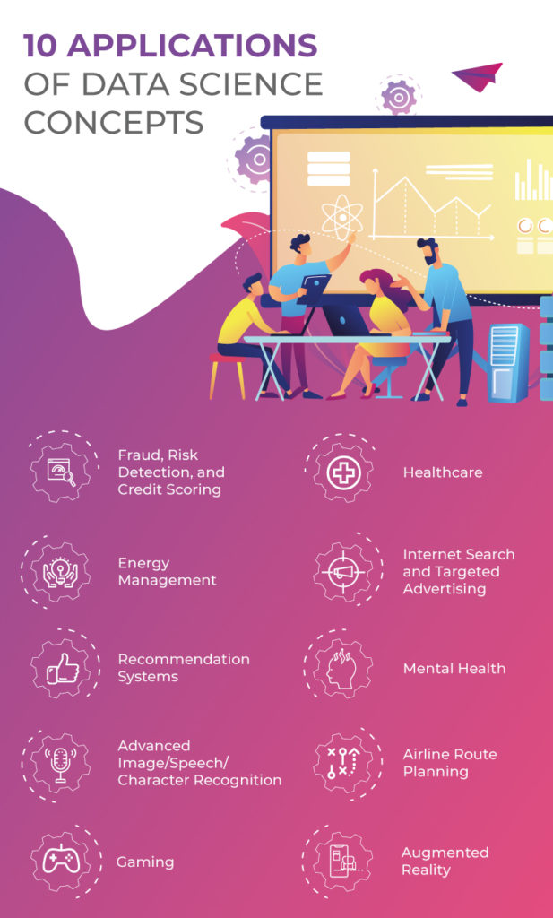

Slide 7


Thank you

